Slide 1
Speaking assignment: How to be a good ……
You are going to give tips on how to excel at something.
You will use commands: a minimum of
5 positive (do this)
5 negative (don’t do this)
Add more to your phrase than then one-word command…give details!
These can be ridiculous/silly. Just make sure they are appropriate!
This will be your speaking assessment for this chapter. You can have prompts up there to help you, but you should not need to read directly off the paper. (practice!)
Feel free to create a visual aid to illustrate your directions!

Slide 2
How to be a good…
Friend
Roommate
Sibling
Student
Tutor
Principal
Daughter/son
Sports player
Sports fan
Instrument player
Girlfriend/boyfriend
Parent
Boss
Gamer/ other game player
Cook/maker of a specific meal

Slide 3
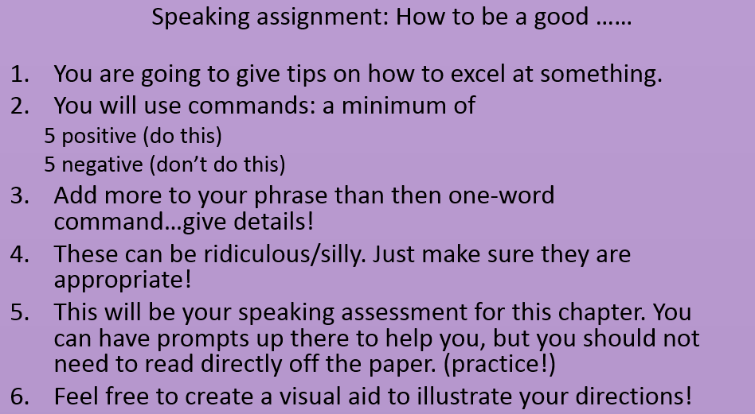
How to be a good…
Friend
Roommate
Sibling
Student
Tutor
Principal
Daughter/son
Sports player
Sports fan
Instrument player
Girlfriend/boyfriend
Parent
Boss
Gamer/ other game player
Cook/maker of a specific meal
Think of what to say, not say, eat/not eat, what to do each day, how to behave in general….

Slide 4
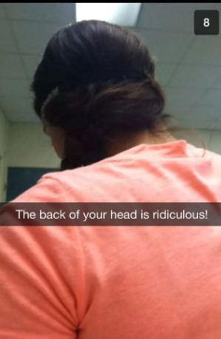
Ejemplos: 5 +, 5 – (can only repeat verbs 1 time)
Cómo ser un buen estudiante:
1. Estudia todos los días
2. No esperes hasta el
último momento
3. Toma apuntes
4. No uses snapchat
durante la clase

Slide 5
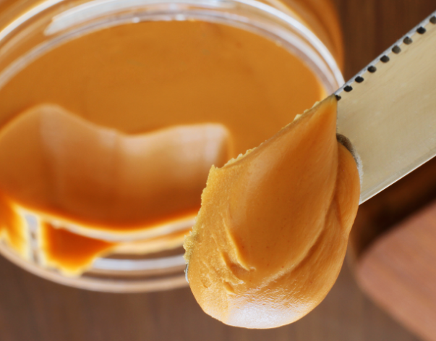
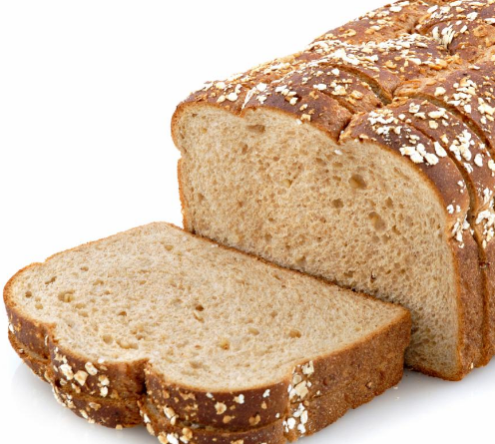
OR silly:
Cómo preparar un sándwich:
Usa el pan para empezar.
No uses papel.

