Slide 1
Hoy:
Nombres
Verbos nuevos
¿Te gusta?
Vocabulario
Papel

Slide 2
¡Las actividades nuevas!

Slide 3
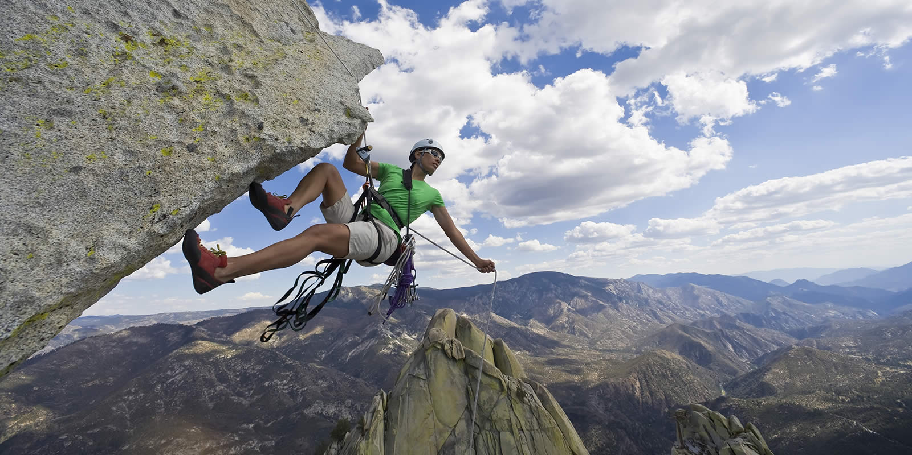
Escalar montañas

Slide 4
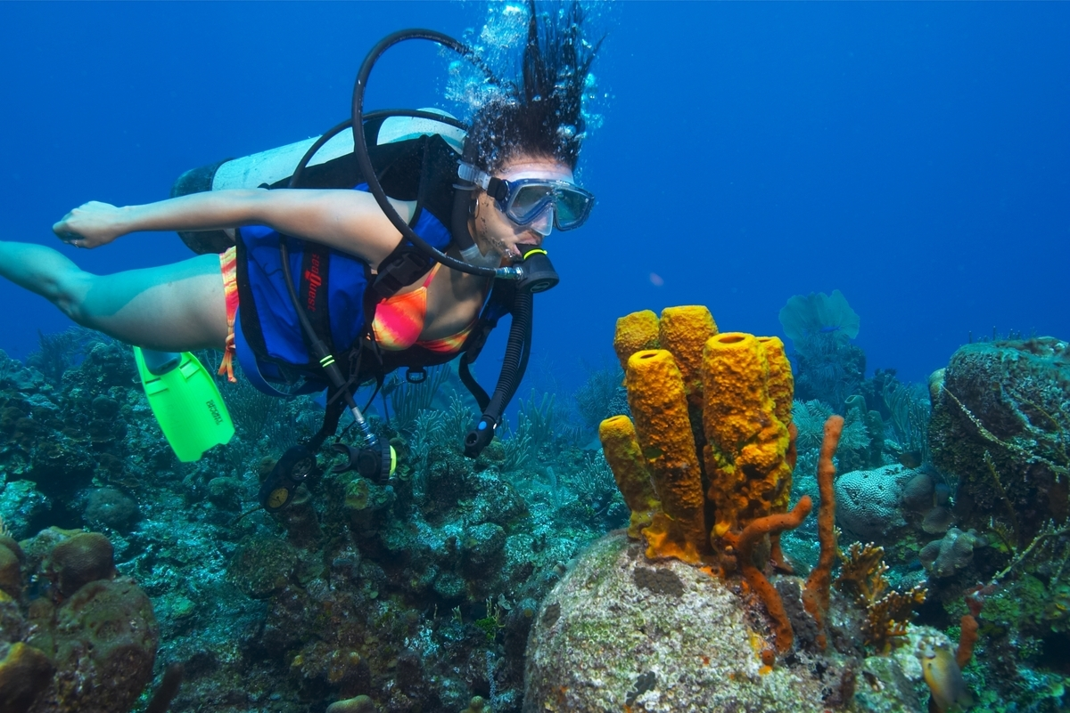
Bucear

Slide 5
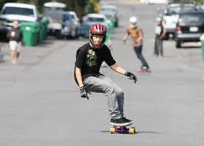
Andar en patineta

Slide 6
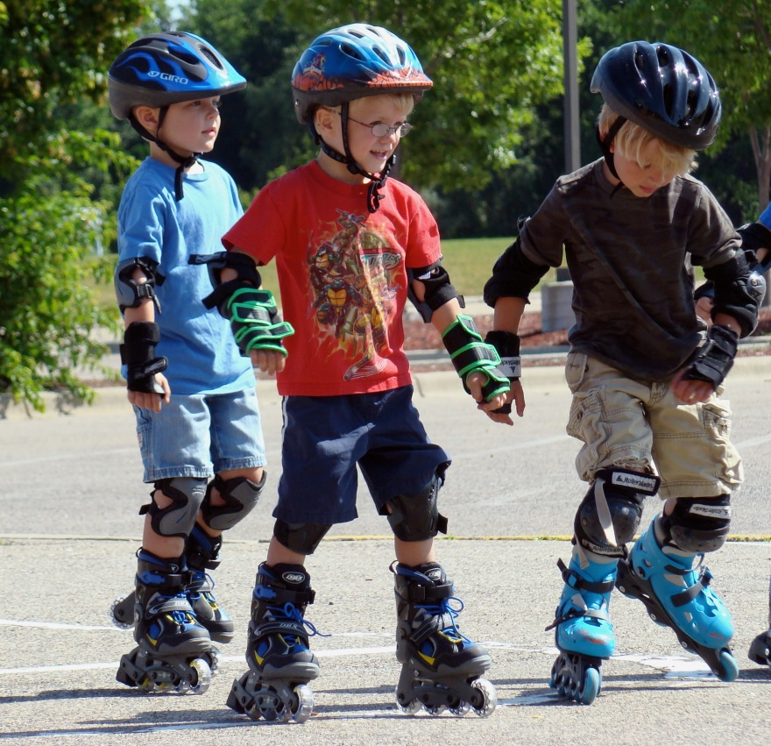
Patinar en linea

Slide 7
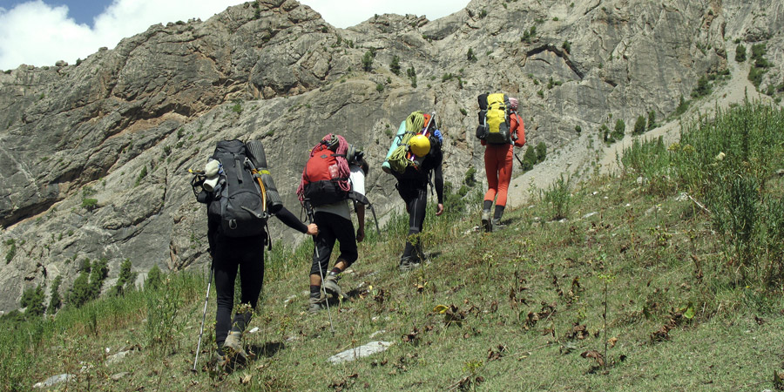
Ir de excursión

Slide 8
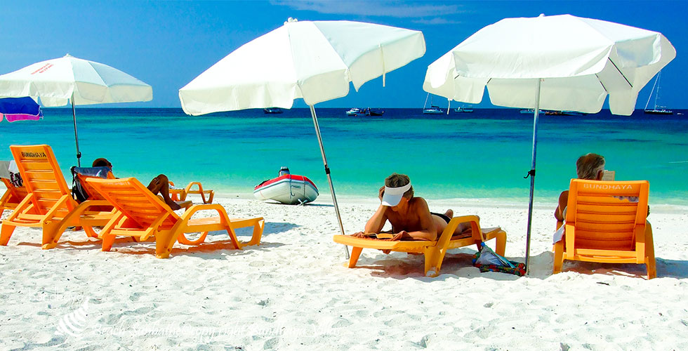
Tomar el sol

Slide 9
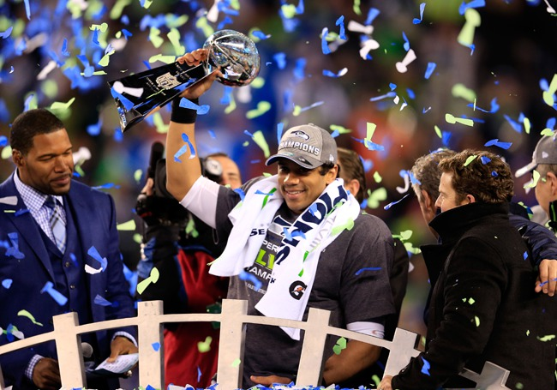
ganar

Slide 10
Ir de compras

Slide 11
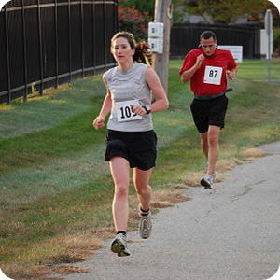
Correr

Slide 12
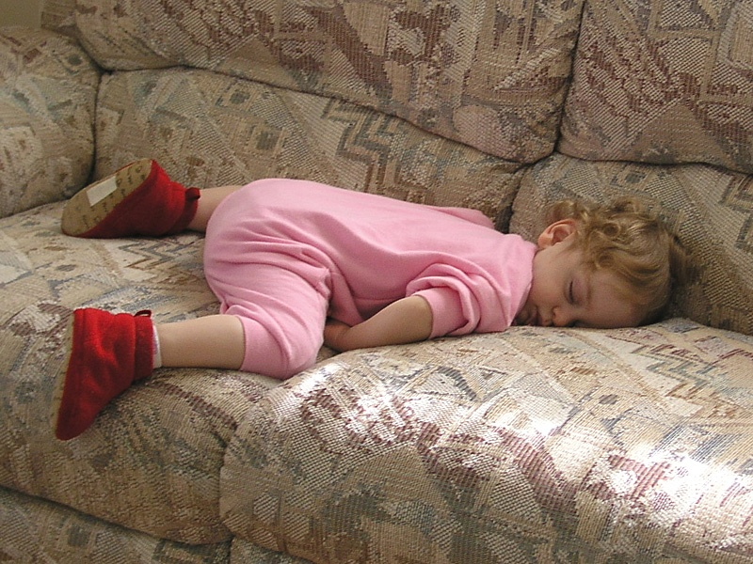
Descansar

Slide 13
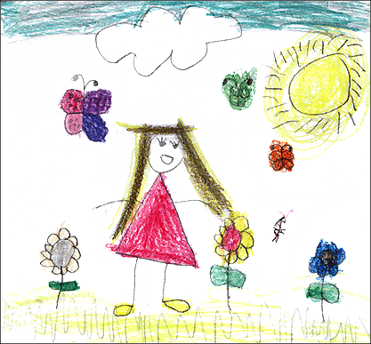
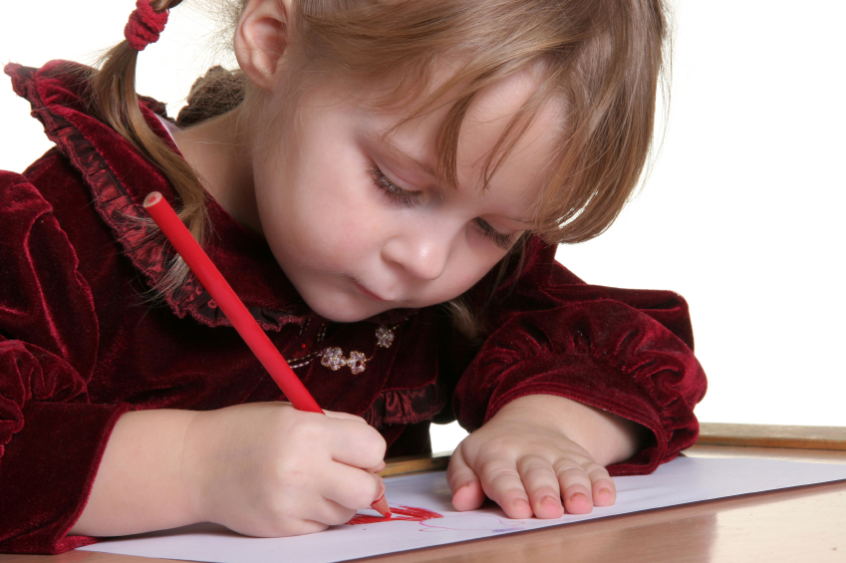
Dibujar

Slide 14

Escribir una carta
Escribir un mensaje electrónico

Slide 15
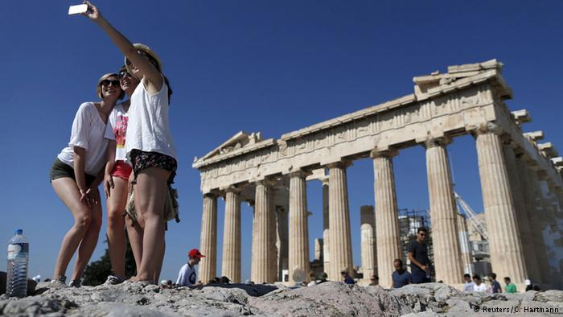
Visitar monumentos

Slide 16

Estudiar

Slide 17
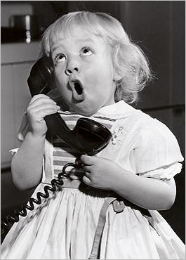
Hablar (por teléfono)

Slide 18
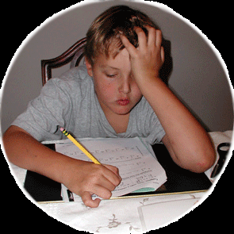
Hacer (la tarea)

Slide 19
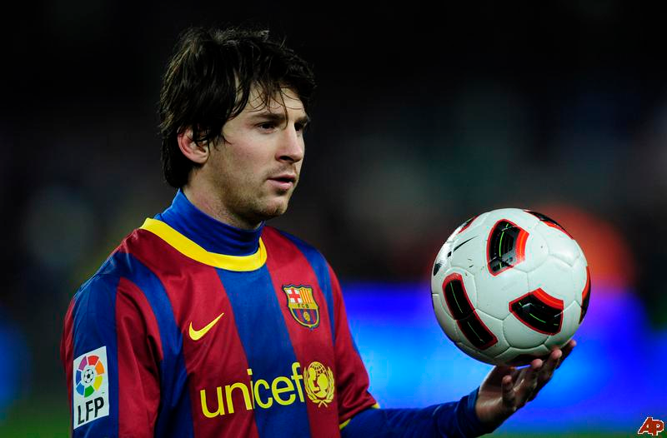
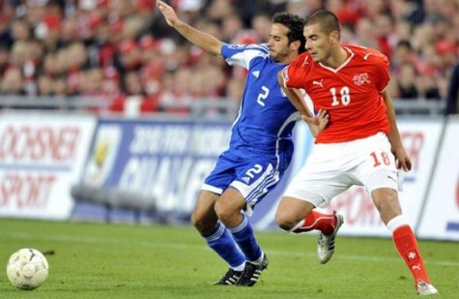
Jugar (al fútbol)
Practicar deportes

Slide 20
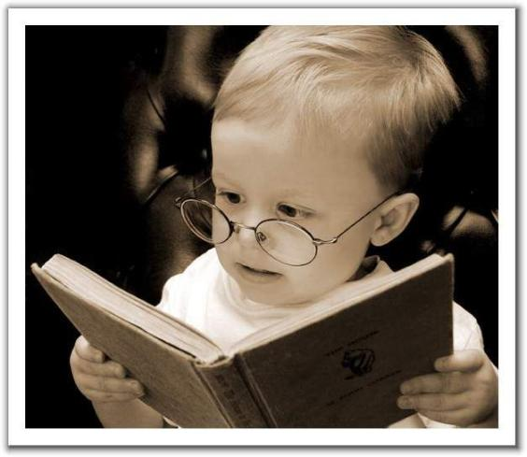
Leer (un libro)

Slide 21
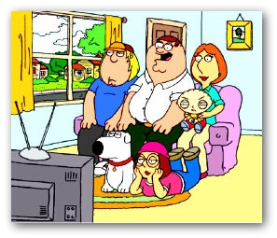
Mirar (la televisión)
Ver (la televisión)

Slide 22
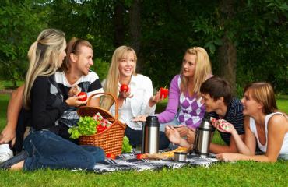
Pasar un rato (con amigos)

Slide 23
Practicar (deportes)

Slide 24
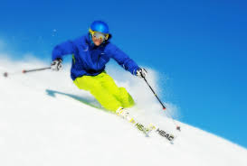

Slide 25
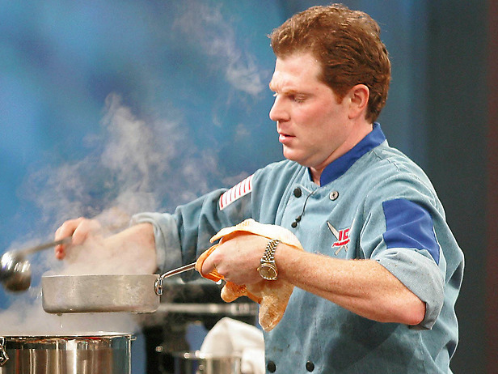
Preparar la comida

Slide 26
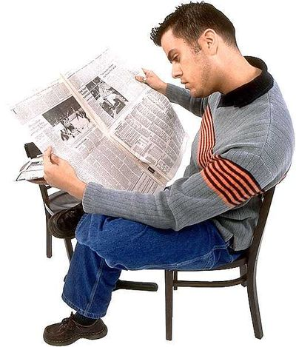
Leer el periódico

Slide 27

Leer una revista

Slide 28
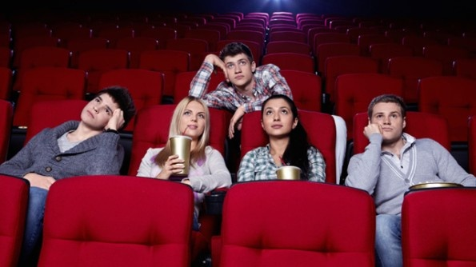
Ver películas
(en el cine)

Slide 29
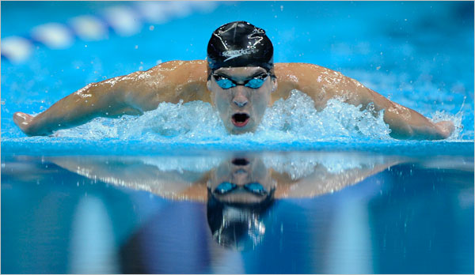
Nadar

Slide 30
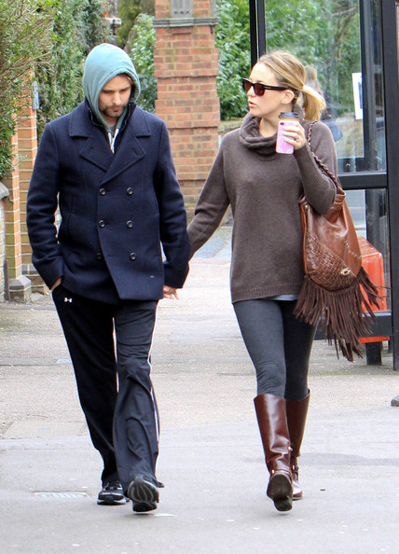
Pasear

Slide 31
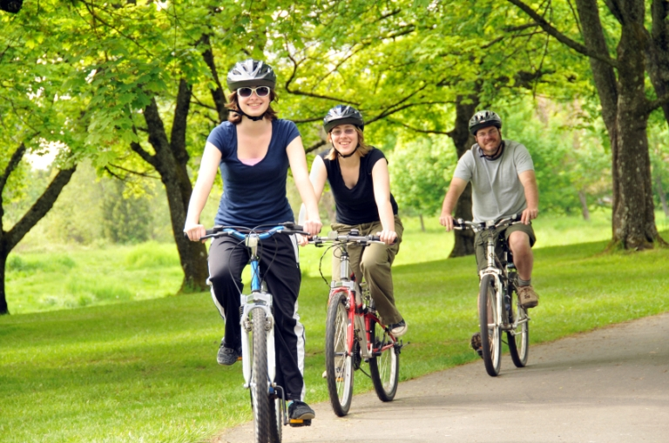
Pasear en bicicleta

Slide 32
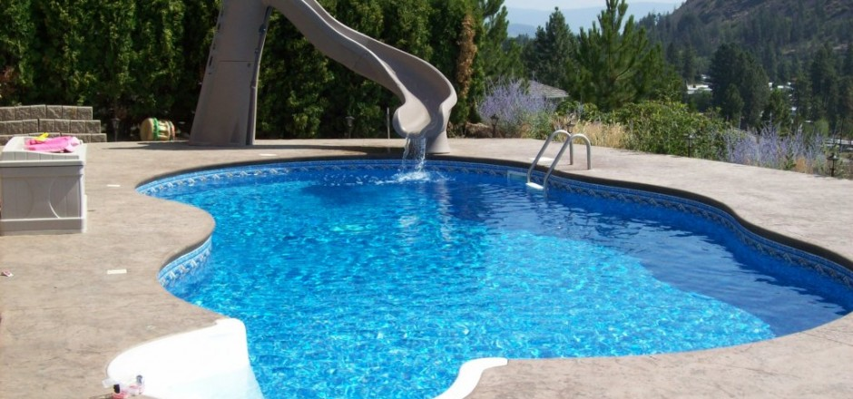
La piscina / la alberca

Slide 33
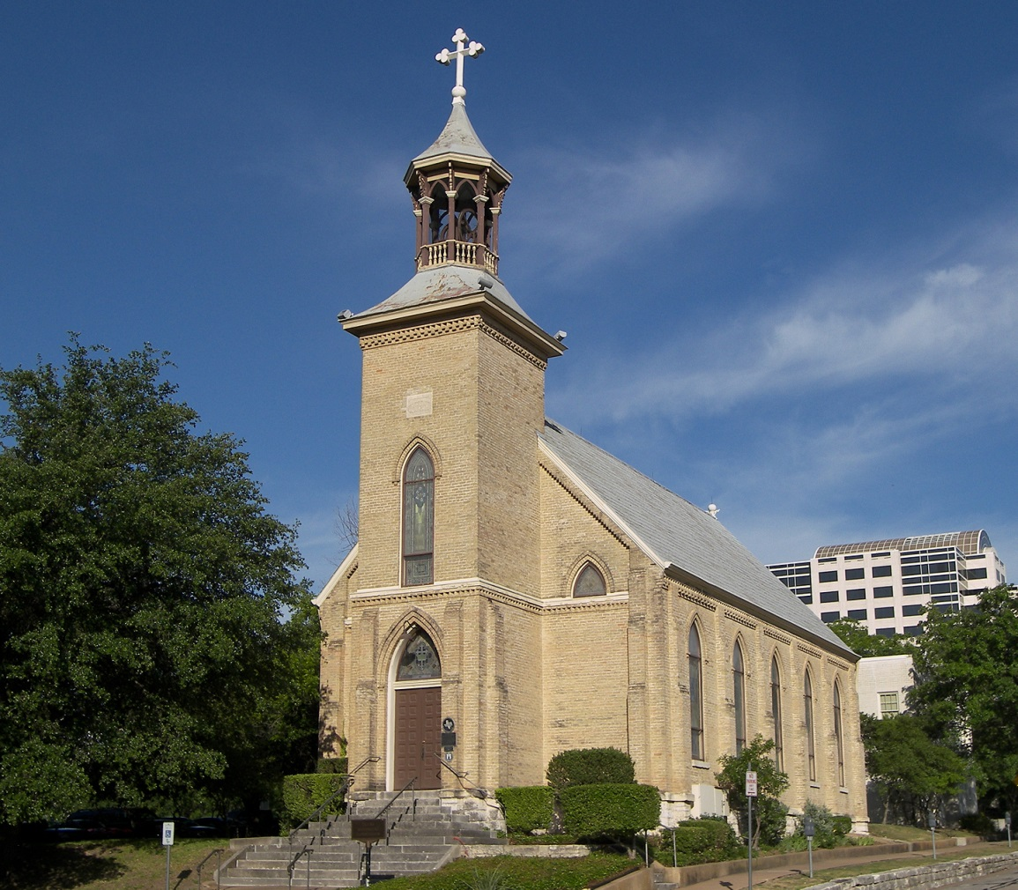
La iglesia

Slide 34
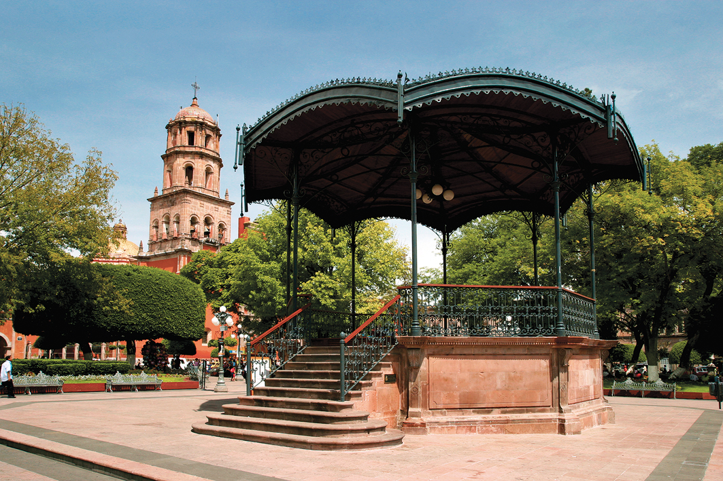
El centro la plaza

Slide 35
GUSTAR
Saying what someone likes

Slide 36
GUSTAR
A VERB is an ACTION WORD.
GUSTAR is used to say when something is pleasing to someone.
But to simplify this, we are going to say that GUSTAR = to like.

Slide 37
GUSTAR
I like = me gusta
You like = te gusta
He/ she/ you (formal) likes = le gusta
We like = nos gusta
They/all of you like = les gusta

Slide 38
Look familiar?
Me gusta (I like) | Nos gusta (We like, someone and I like)
Te gusta (you like)
Le gusta (he likes, she likes, you formal like) | Les gusta (they masculine like, they feminine like, all of you like, someone and you like )

Slide 39
GUSTAR
To like an activity!
To say someone likes an activity, you use “gustar” with the INFINITIVE of the verb.
The INFINITIVE means the basic form of a verb.
In English, the infinitives begin with “to.”
Examples: to run, to laugh, to listen.

Slide 40
GUSTAR
In Spanish, VERBS end with:
- AR, - ER, or – IR.
You already know some verbs that you can use with gustar.
Ejemplos?
Practice saying a few things you like to do.
Then, ask your pareja, “Qué te gusta hacer?”
Have him/her respond.
Then he/she will ask the same question.
You respond!

Slide 43
GUSTAR
If you can handle it:
We say “me gusta bailar” means
“I like to dance” BUUUUUUT what you are REALLY saying is:
“To dance is pleasing to me.”

Slide 44
GUSTAR
Don’t get that? Don’t worry about it.
For now, just understand the following:
I like = me gusta
You like = te gusta
He/ she/ you (formal) likes = le gusta
We like = nos gusta
They/all of you like = les gusta

Slide 45
GUSTAR
I like to read = Me gusta leer.
Como se dice (how do you say):
  1. I like to dance._____________________.
  2. He likes to skateboard. ____________________
  3. I like to swim. ______________________.
  Wait, what if I DON’T like to do those things???

Slide 46
GUSTAR
To say you DON’T like to do something, you just add “NO” to the beginning.
I don’t like to swim = No me gusta nadar.
6. I don’t like to swim= _______________.
7.He does not like to draw= _______________.
8. I don’t like to read. _______________
9.I don’t like to skateboard. ____________________________
10. She does not like to work. ____________________________

Slide 47
GUSTAR
When ASKING if someone likes to do something, it’s all in the voice: your vocal inflection needs to make it sound like a question. When writing, you use an upside down question mark at the beginning and a regular one at the end.
Do you like to dance? ¿Te gusta bailar?
Do you like to work? ¿Te gusta trabajar?

Slide 48
GUSTAR
To ANSWER a question positively:
Yes, I like to dance = Sí , me gusta bailar.
To ANSWER a question negatively:
No, I don’t like to dance =
No, no me gusta bailar.
(you need 2 NOs = one for “No,” one for “don’t”)

Slide 49
GUSTAR
(add the verb cantar to your packet! ON QUIZ! MEANS TO SING!)
Write the following in Spanish:
I like to dance. _______________.
He likes to skateboard. __________________
I like to swim. _____________________.
I like to sing. _______________.
She likes to read. _______________

Slide 50
GUSTAR
I don’t like to swim = __________________
He does not like to draw= ______________
I don’t like to read = __No me gusta leer____.
I don’t like to skateboard = _No me gusta andar en patineta____.
She does not like to work.__No le gusta trabajar.___
You don’t like to eat? _¿No te gusta comer?___

Slide 51
GUSTAR
Write the following in Spanish:
I like to swim.
I like to read.
You like to skate.
You like to eat.
I like to dance.
He likes to sing.
He likes to work.

Slide 52
GUSTAR
Write the following in Spanish:
I like to swim. Me gusta nadar.
I like to read. Me gusta leer.
You like to skate. Te gusta patinar.
You like to eat. Te gusta comer.
I like to dance. Me gusta bailar.
He likes to sing. Le gusta cantar.
He likes to work. Le gusta trabajar.

Slide 53
GUSTAR
Now, translate the following questions:
Do you like to dance? ¿Te gusta bailar?
Do you like to skate?
Do you like to run?
Do you like to work?
Does he like to swim?
Does she like to sing?

Slide 54
GUSTAR
Now, go back and ANSWER, in SPANISH, numbers 1-4.
Do you like to dance?
Do you like to skate?
Do you like to write?
Do you like to read?

Slide 55
GUSTAR
Lulu hates doing anything. Pretend your are Lulu. Respond to the following questions:
¿Te gusta bailar? _____________________
¿Te gusta cantar? ___________________
¿ Te gusta patinar? __________________
¿ Te gusta escribir?___________________

Slide 56
Pronouns
a mí (Me gusta) | A someone else y a mí A nosotros (nos gusta)
a ti (Te gusta) | X
a él/ a ella / a usted (Le gusta) | A ellos/a ellas/ a ustedes (Les gusta)

Slide 57
We like to swim.___________________________
They like to go shopping.____________________
Paula likes to run._________________________
Laura likes to read.________________________
Manuel likes to talk. _____________________
The boys like to play soccer.___________________
Your friends don’t like to study.________________
His dad likes to work._______________________
My friend and I don’t like to do HW. ______________________________________

Slide 58
(a mí) Me gusta | A [someone else ]y a mí) A nosotros nos gusta
(a ti) Te gusta | X
(a él/ a ella / a usted Le gusta | (A ellos/a ellas/ a ustedes) Les gusta

